Slide 1

Finance
1st meeting
2022.07.24 by David yang

Slide 2


AGENDA
Try to draw Decomposition in Tableau
Prepare for database
Design descriptive analysis dashboards
EDA and Data Preprocessing
Machine Learning

Slide 3
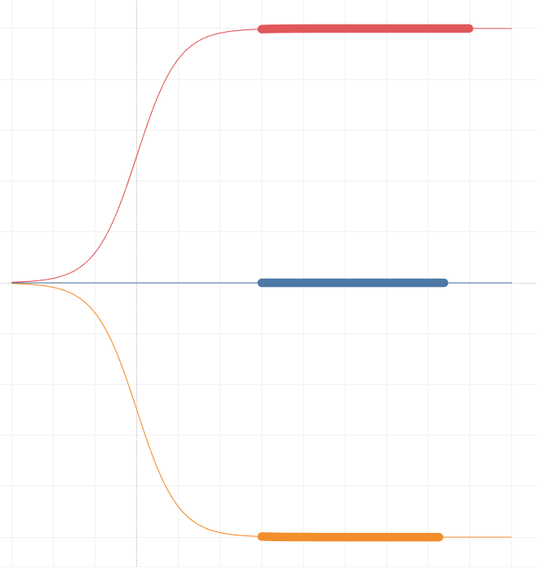
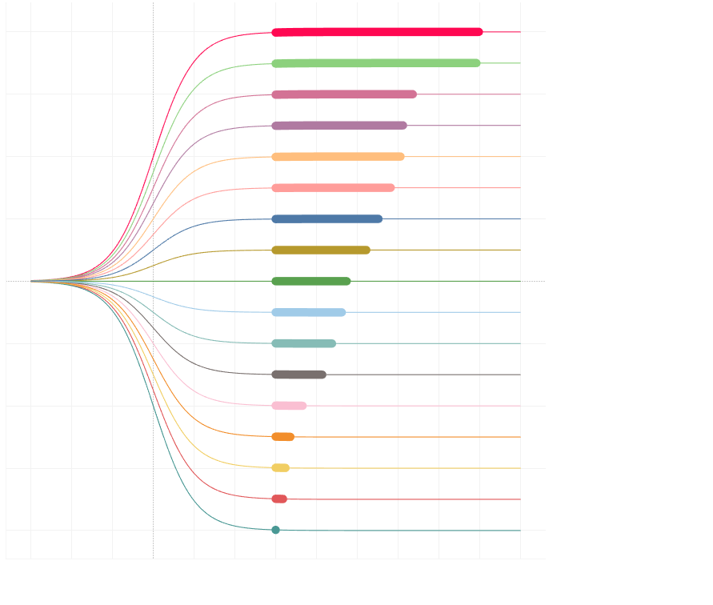
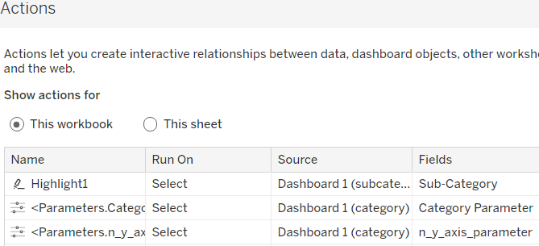
Decomposition in Tableau

Slide 4
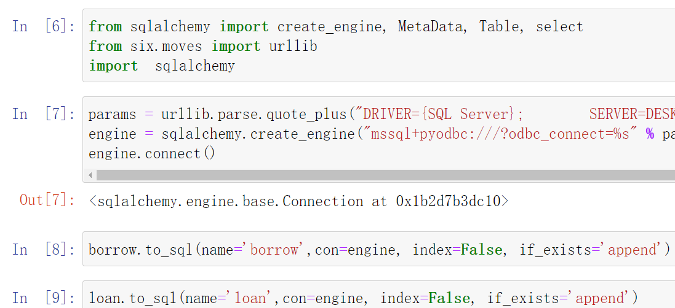
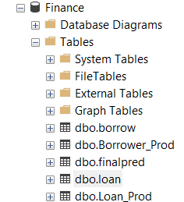
Prepare for database

Slide 5
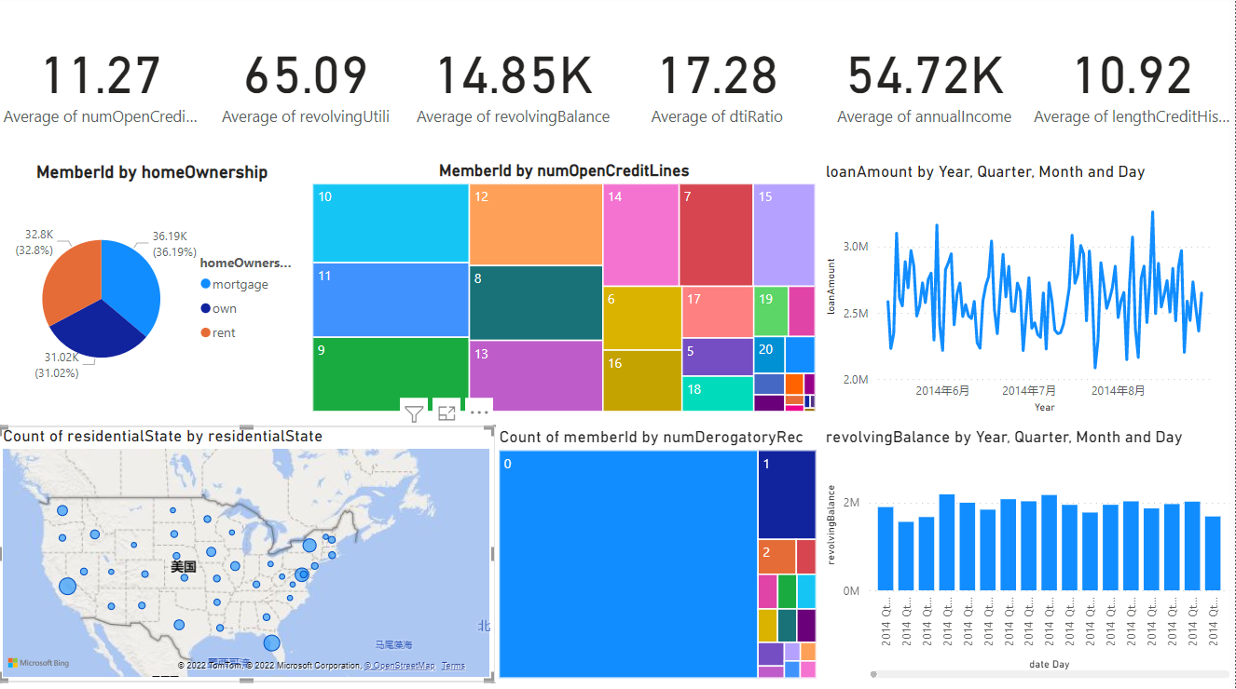
Loan Summary

Slide 6
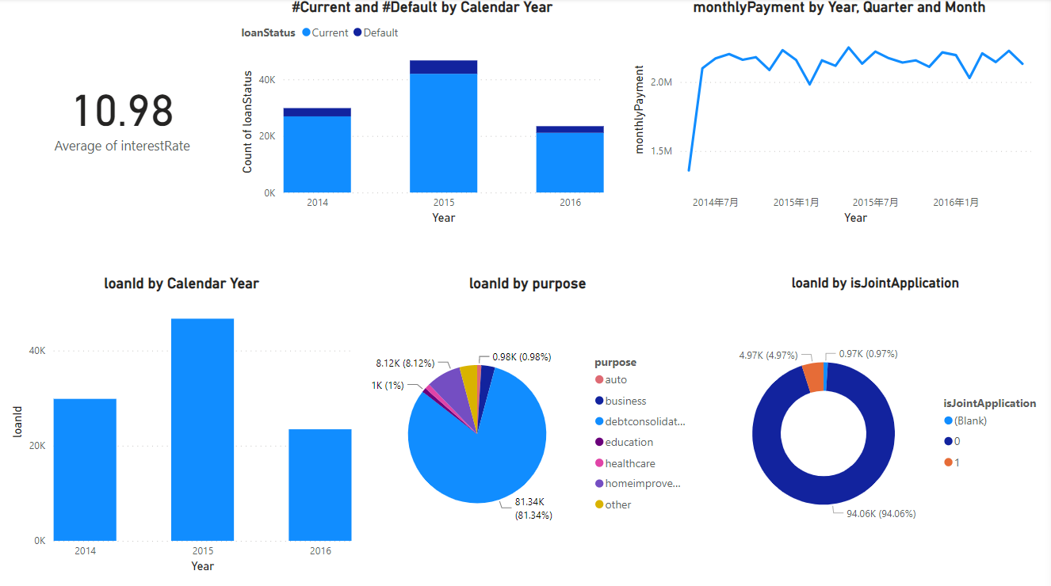
Borrower Summary

Slide 7
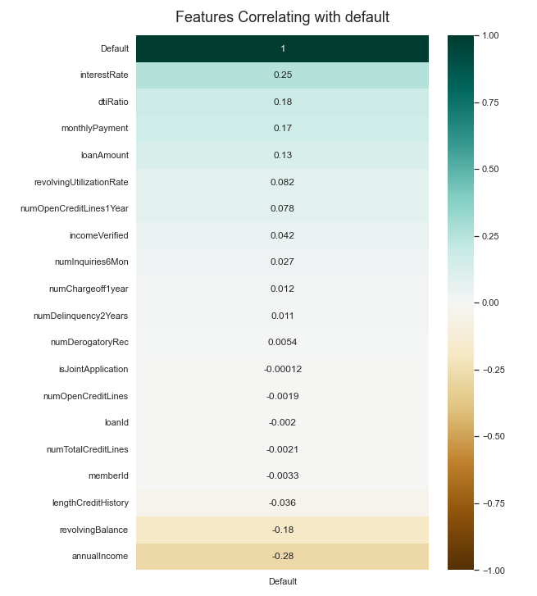
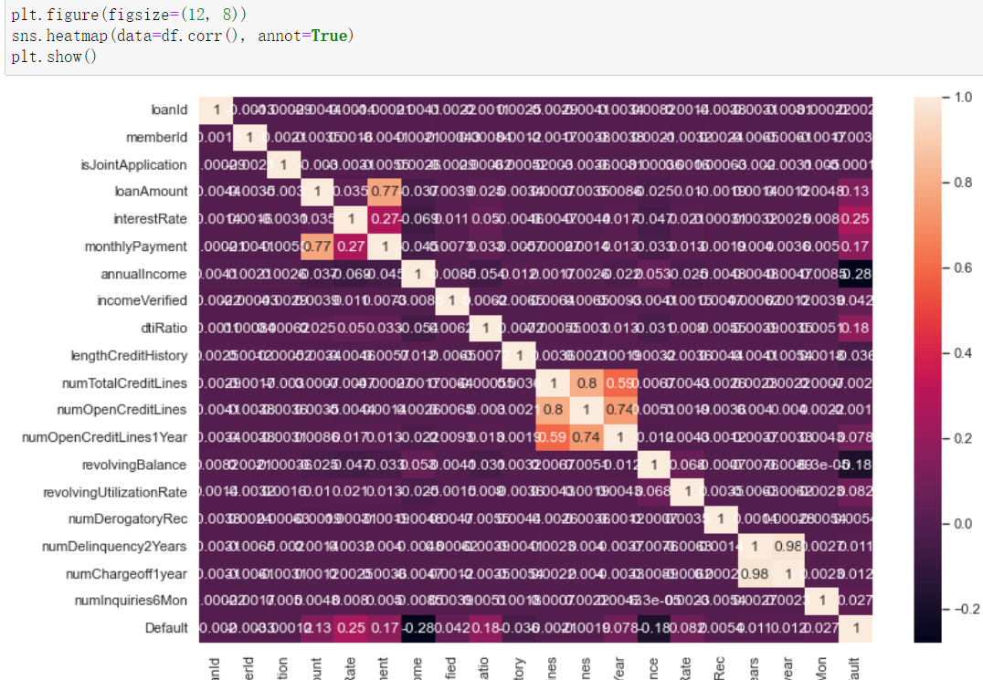
Exploratory Data Analysis

Slide 8
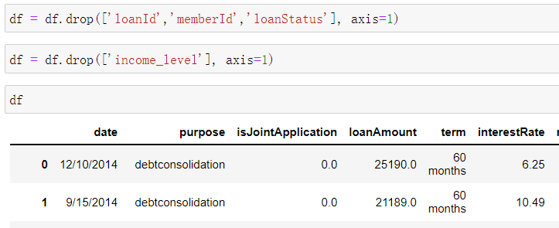
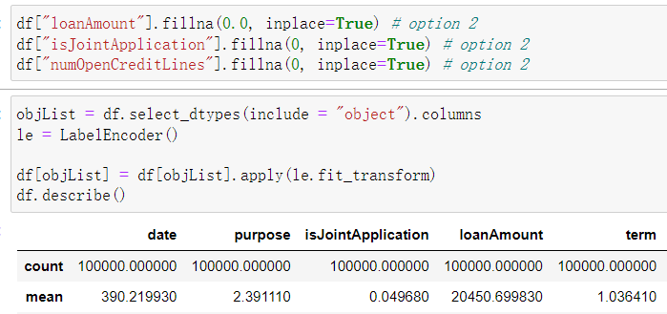

Data Preprocessing

Slide 9
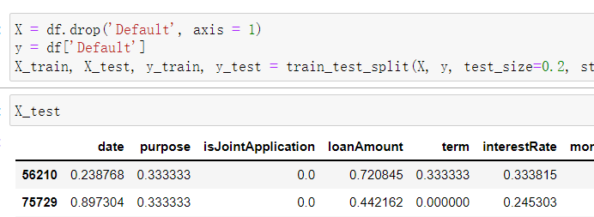
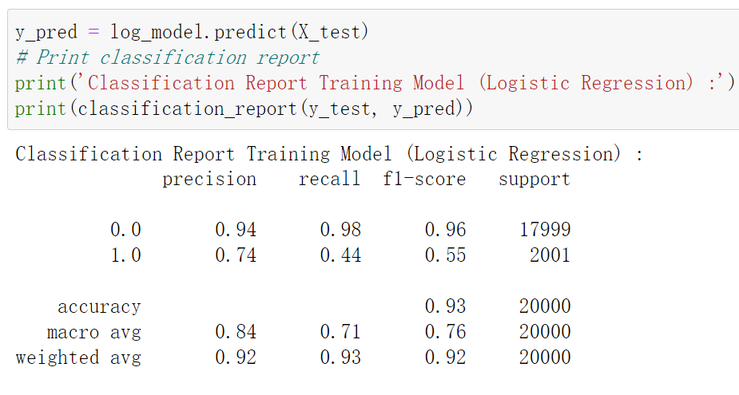
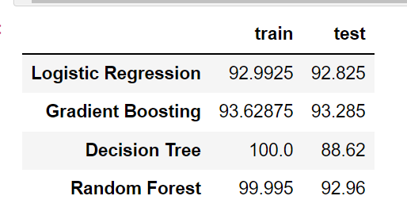
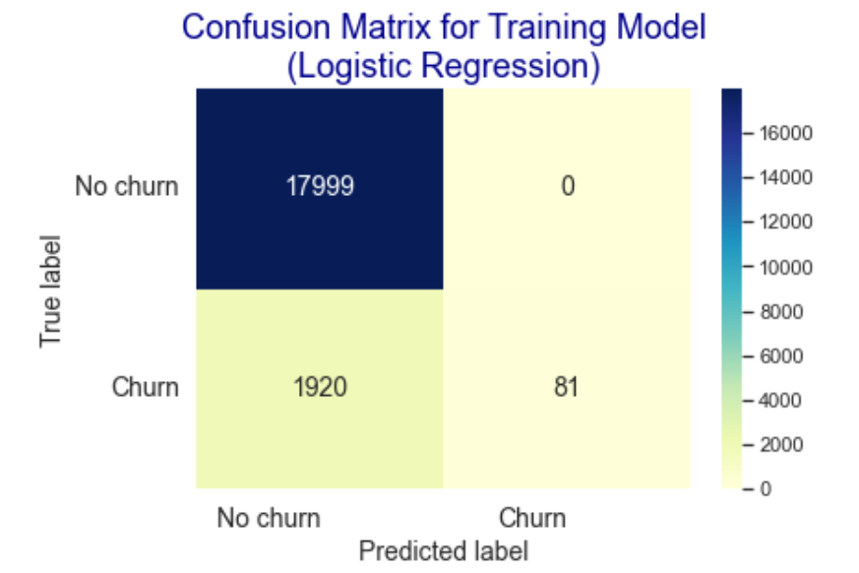
Machine Learning

Slide 10
Finance
2nd meeting
2022.08.06 by David yang

Slide 11
AGENDA
Data processing
Machine learning
New loan data processing and prediction
Analysis dashboard designing

Slide 12
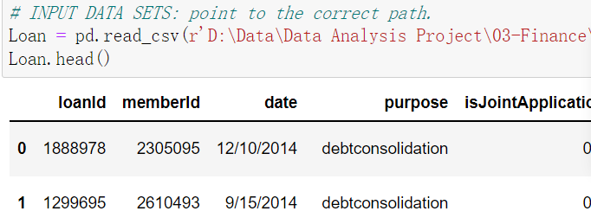
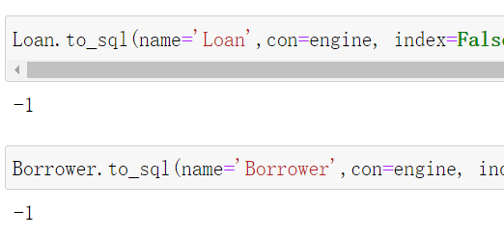



Data processing
Add new column and drop redundant columns

Slide 13

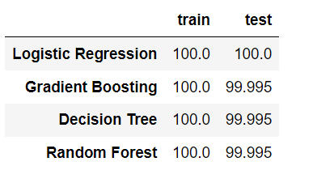

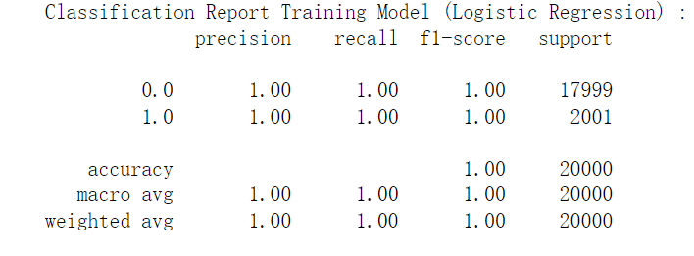

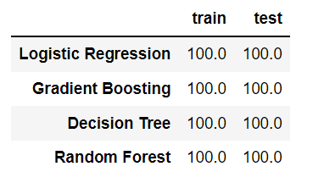


Machine learning

Slide 14


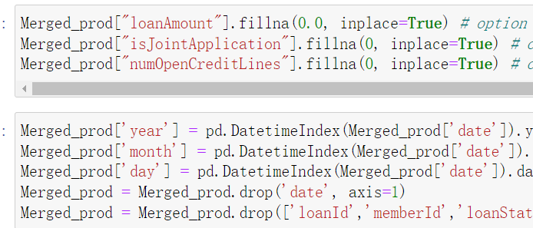

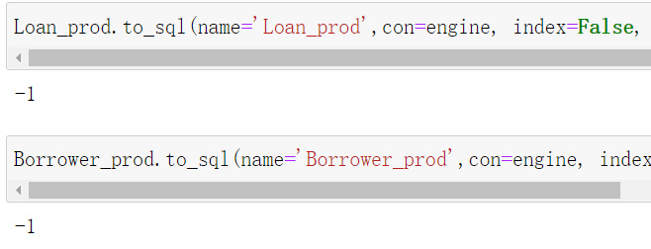
New loan data processing and prediction

Slide 15
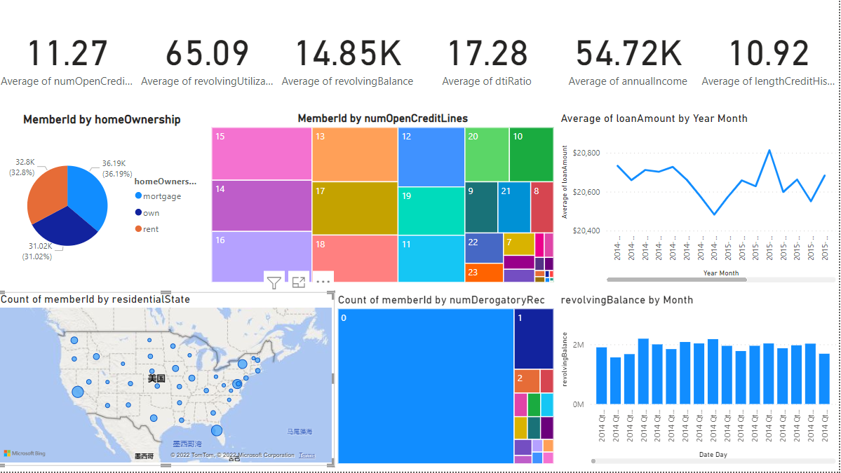
Borrower Summary

Slide 16
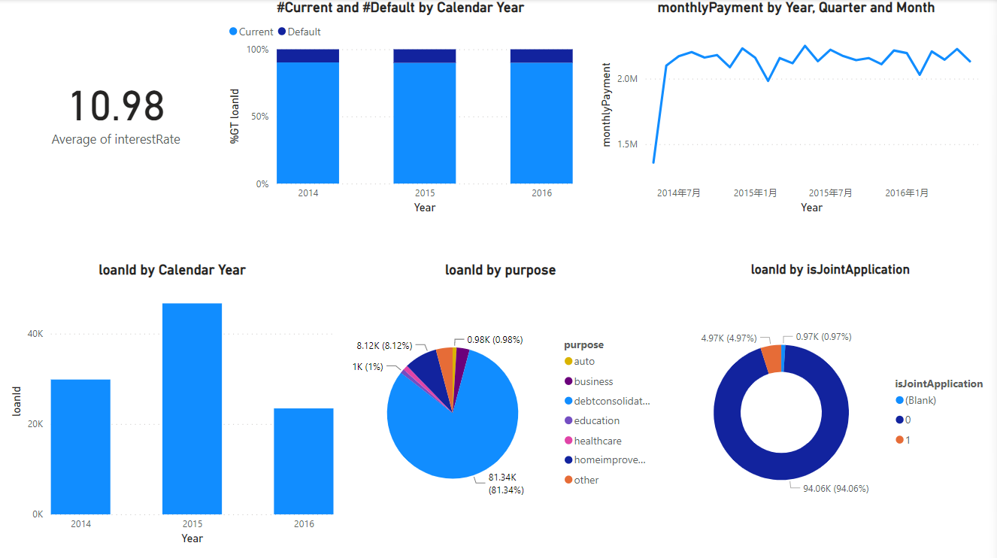
Loan Summary

Slide 17
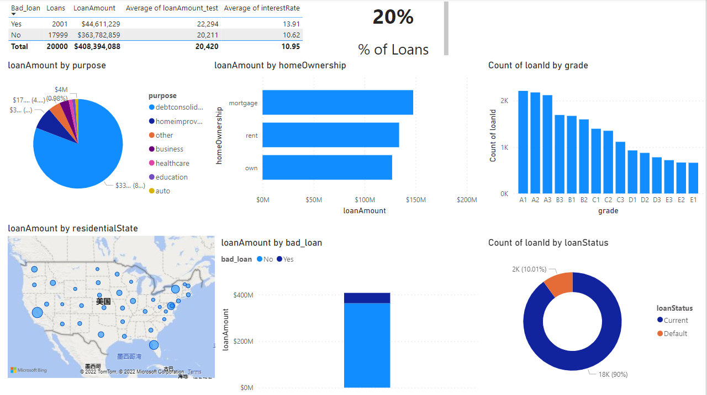
Current loans data Table

Slide 18
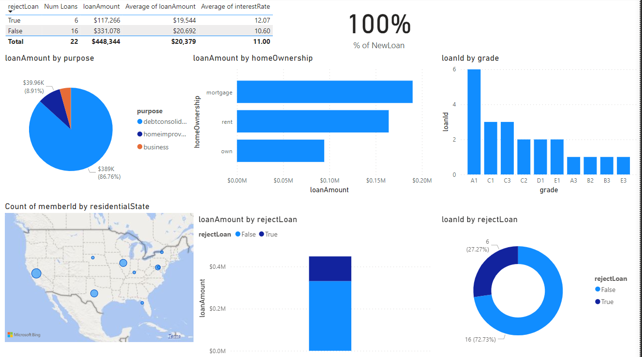
New Loans Table

Slide 19

thanks

